Slide 1

Module 13: Disaster Recovery and High Availability

Slide 2
Topics
How High Availability and Disaster Recovery work together
Building highly available systems on AWS
Best practices for high availability and disaster recovery
Common patterns of disaster recovery on AWS

Slide 3
Topics
How High Availability and Disaster Recovery work together
Building highly available systems on AWS
Best practices for high availability and disaster recovery
Common patterns of disaster recovery on AWS

Slide 4
How Availability and Disaster Recovery
Think of it as a spectrum
It’s part of a business continuity plan
It’s not an all or nothing proposition
In the face of internal or external events, how to you….
Keep your application running 24x7
Make sure your data is safe
Get an application back up after a major disaster
High Availability
Disaster Recovery

Slide 5
How Availability
HA is one end of the spectrum
Rather than recovery with defined RTO/RPO, design for continuous availability
Goal: application never goes down
Eliminate single points of failure
“Self Healing” app recovers automatically from component failures
Use graceful degradation if necessary
Traditional IT model: HA is very expensive, suitable only for absolutely mission-critical apps

Slide 6
How Availability Terms
Uptime: period when system is availability for use
Downtime (or Outage): period when system is unavailable for normal function or offline
Graceful Degradation: system continues to be available, but at a reduced level of service or function
Availability: percentage uptime in a given period (nines)
99,999% (“five nines”) availability= no more than about 5 minutes downtime per year

Slide 7
Disaster Recovery on the spectrum
Recover from any event
Recover Time Object (RTO)
Acceptable time period within which normal operation (or degraded operation) needs to be restored after event
Recovery Point Object (RPO)
Acceptable data loss measured in time
Traditional IT model has DR in a second physical site
Low end DR: off-size backups
High end DR: hot size active-active architecture

Slide 8
Topics
How High Availability and Disaster Recovery work together
Building highly available systems on AWS
Best practices for high availability and disaster recovery
Common patterns of disaster recovery on AWS

Slide 9
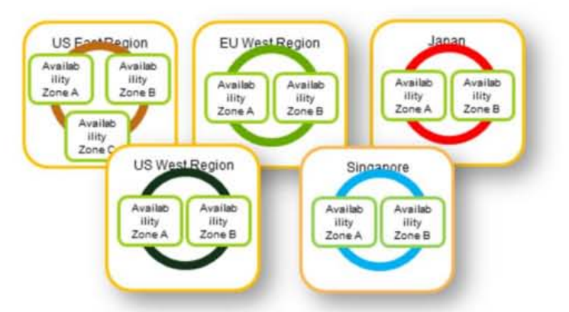
AWS: Regions and Availability Zones
Regions are completely separate clouds
Multi network-connected Availability Zones in each Region

Slide 10
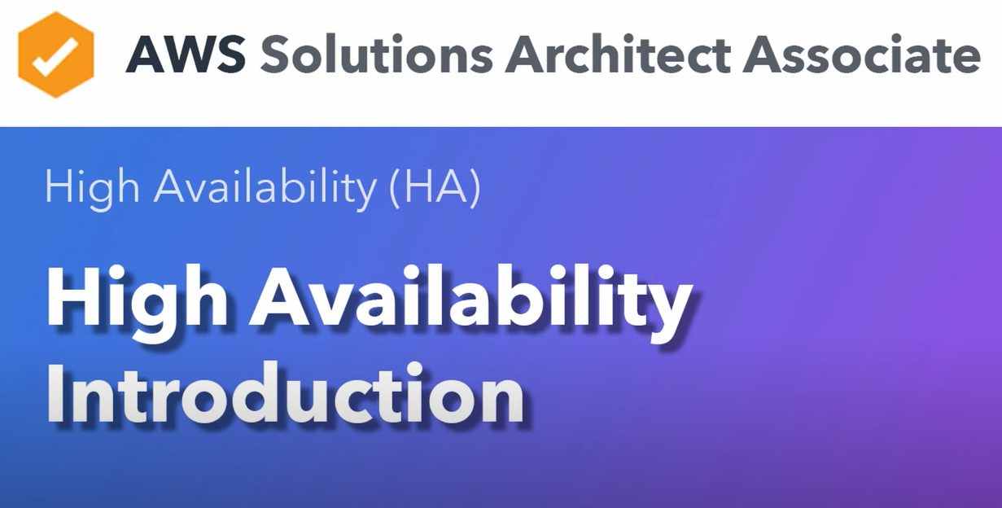

Slide 11
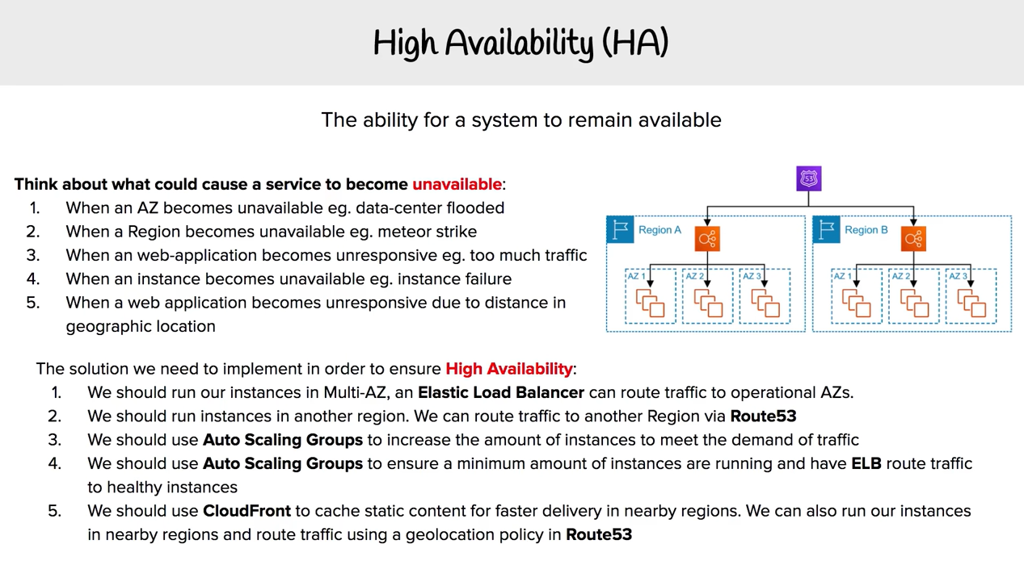

Slide 12


Slide 13
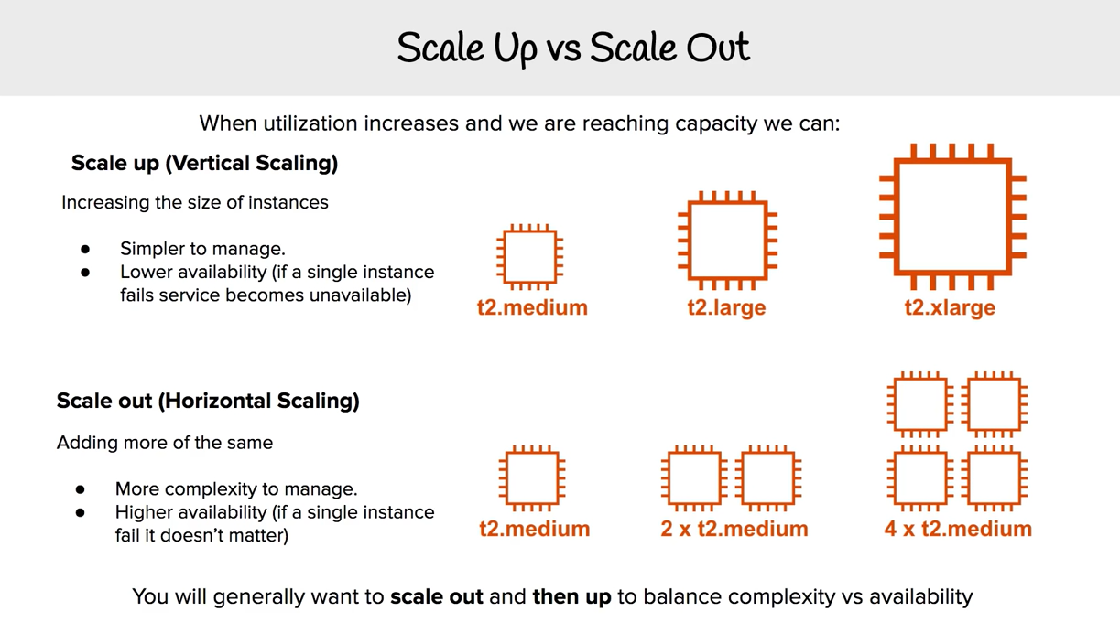

Slide 14
Take advantage of multiple availability zones
No cost difference between servers running in a single AZ versus multiple Azs
Most services are designed with multiple AZ use in mind

Slide 15
Topics
How High Availability and Disaster Recovery work together
Building highly available systems on AWS
Best practices for high availability and disaster recovery
Common patterns of disaster recovery on AWS

Slide 16
Best Practices for HA
Build loosely coupled systems
Queues, load-balance tiers
Implement elasticity
Bootstrapping, load balancing, Auto Scaling, etc…
Instance asks: ”Who am I and what is my role”?
Use abstract machine and system representations
Build images from recipes, stacks from CloudFormation

Slide 17
Design for failure: Basic principles
Goal: Applications should continue to function event if the underlying physical hardware fails or is removed or replaced
Avoid single points of failure
Assume everything fails, and design backwards
Design your recovery process

Slide 18
Topic
How High Availability and Disaster Recovery work together
Building highly available systems on AWS
Best practices for high availability and disaster recovery
Common patterns of disaster recovery on AWS

Slide 19
Common Practices of Disaster Recovery on AWS
Example Architectural Patterns (sorted by increasingly optimal RTO/RPO)
Backup and Restore
Pilot Light
Fully Working Low Capacity Standby
Multi-Site Hot Standby

Slide 20
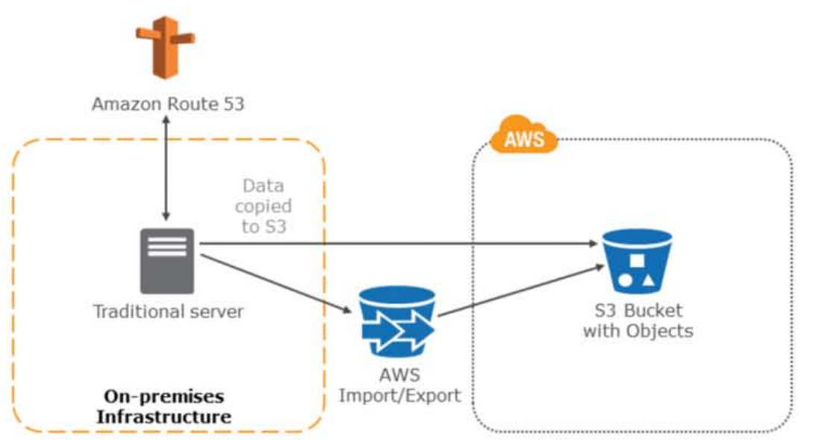
Backup and Restore

Slide 21
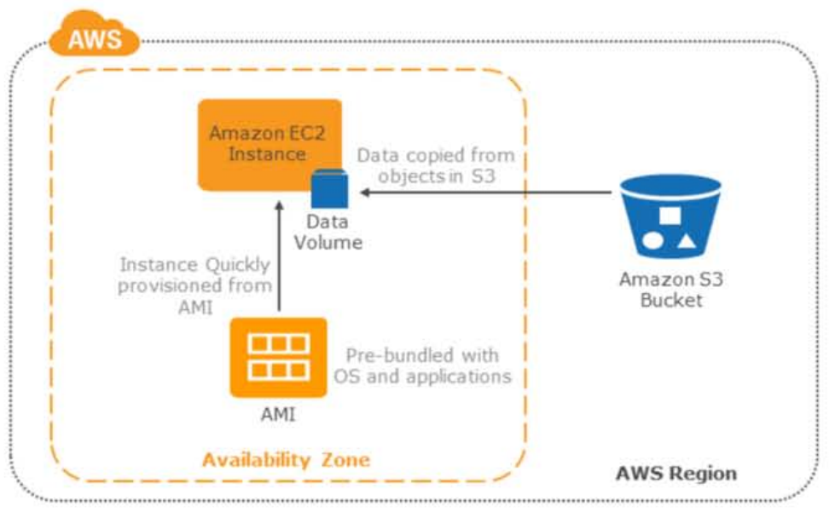
Backup and Restore

Slide 22
Backup and Restore
Advantages
Simple to get started
Extremely cost effective (mostly backup storage)
Preparation Phase
Take backups of current systems
Store backups in S3
Describe procedure to restore from backups on AWS
Know which AMI to use, build your own as needed
Know how to restore system from backups
Know how to switch to new system
Know how to configure the deployment

Slide 23
Common Practices of Disaster Recovery on AWS
In case of disaster
Retrieve backups from S3
Bring up required infrastructure
EC2 instance with prepared AMIs, Load Balancing, etc.
Restore system from backup
Switch over to the new system
Adjust DNS records to point to AWS
Objectives
RTO: as long as it takes to bring up infrastructure and restore system from backups
RPO: time since last backup

Slide 24
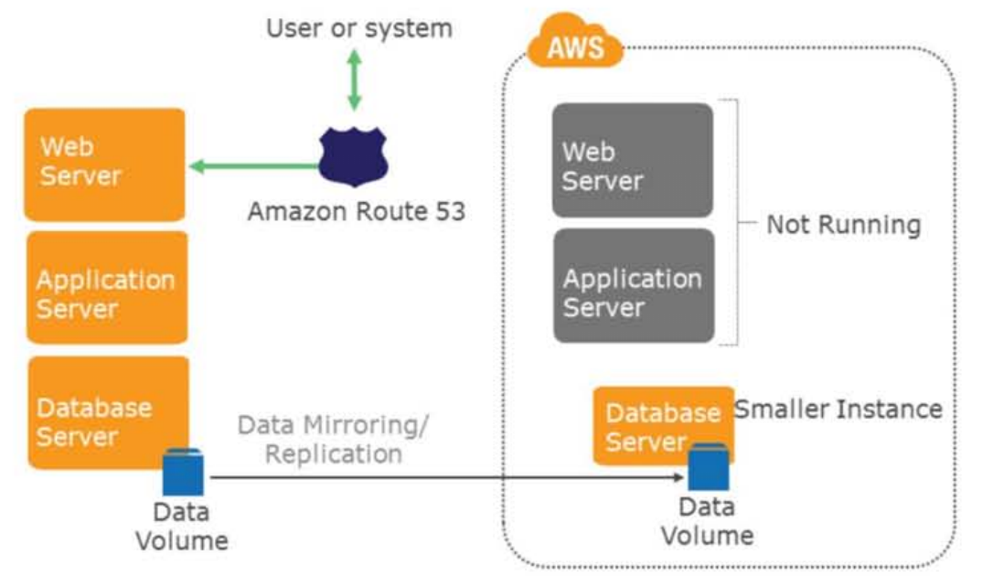
Pilot Light

Slide 25
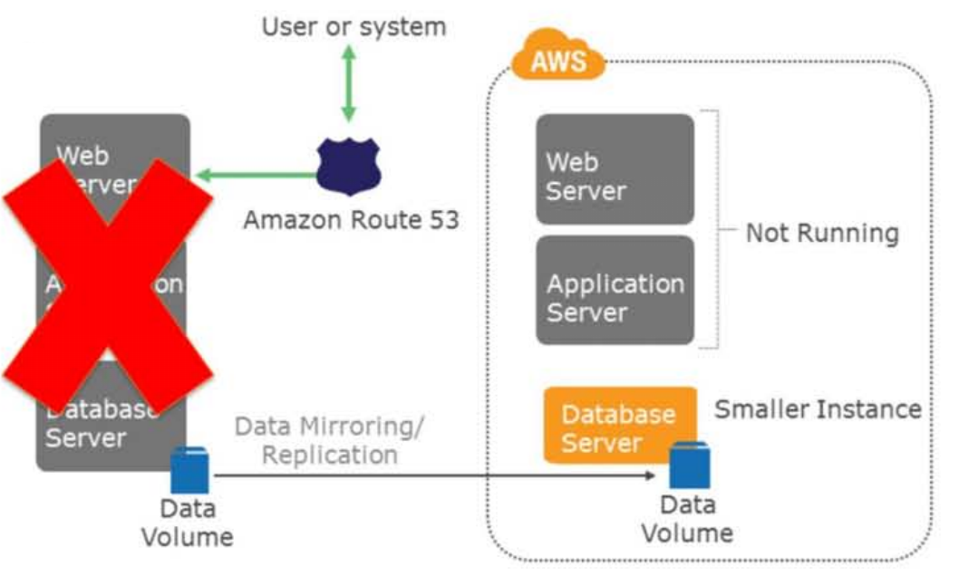
Pilot Light

Slide 26
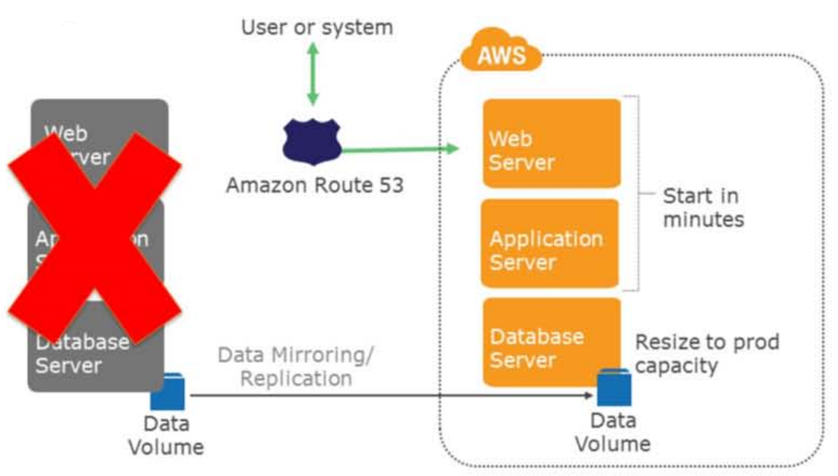
Pilot Light

Slide 27
Pilot Light
Advantages
Very cost effective (fewer 24/7 resources)
Preparation Phase
Enable replication of all critical data a AWS
Prepare all required resources for automatic start
AMIs, Network Settings, Load Balancing, ect..
Reserved Instances

Slide 28
Pilot Light
In case of disaster
Automatically bring up resources around the replicated core data set
Scale the system as needed to handle current production traffic
Switch over to the new system
Adjust DNS records to point to AWS
Objectives
RTO: as long as it takes to detect need for DR and automatically scale up replacement system
RPO: depends on replication type

Slide 29
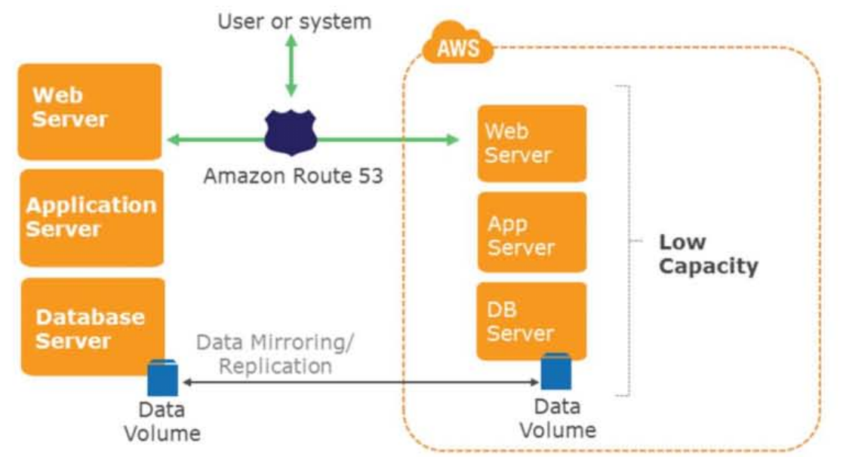
Fully-Working Low Capacity Standby

Slide 30
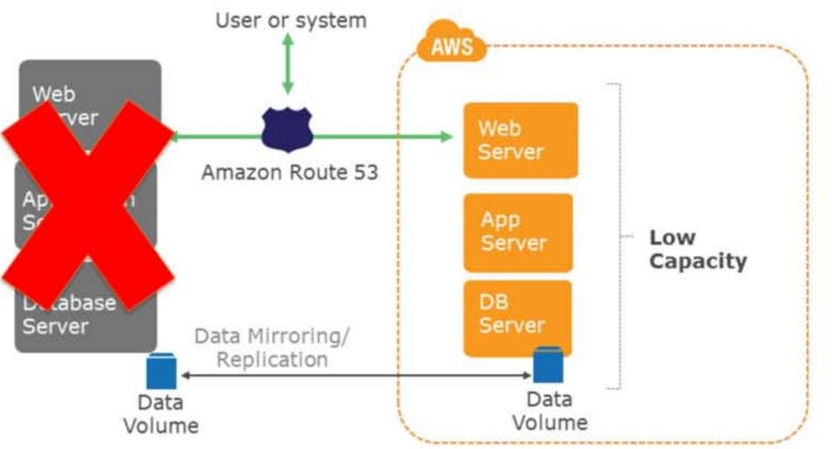
Fully-Working Low Capacity Standby

Slide 31
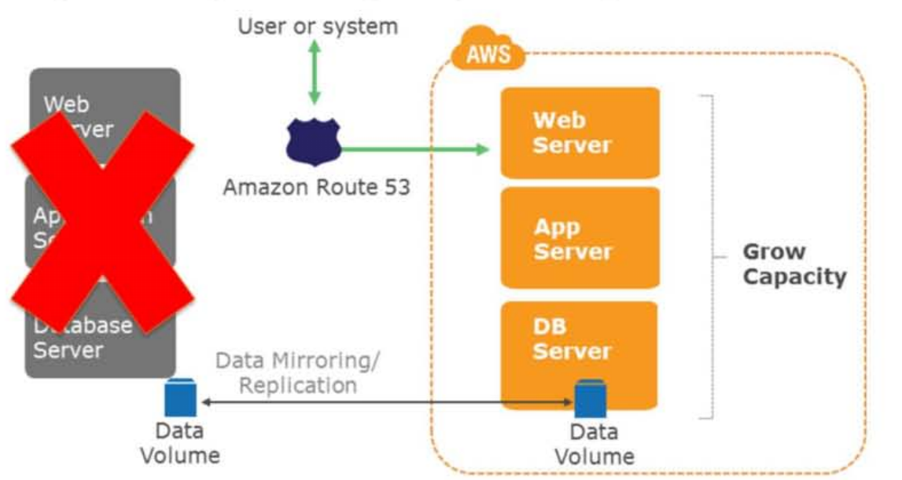
Fully-Working Low Capacity Standby

Slide 32
Fully-Working Low Capacity Standby
Advantages
Can take some production traffic at any time
Cost savings (IT footprint smaller than full DR)
Preparation
Similar to Pilot Light
All necessary components running 24/7, but not scaled for production traffic
Best practice-continuous testing
“Trickle” a statistical subset of production traffic to DR site

Slide 33
Fully-Working Low Capacity Standby
In case of disaster
Immediately fail over most critical production load
Adjust DNS records to point to AWS
(Auto) Scale the system further to handle all production load
Objectives
RTO: for critical load: as long as it takes to fail over; for all other load, as long as it takes to scale further
RPO: depends on replication type

Slide 34
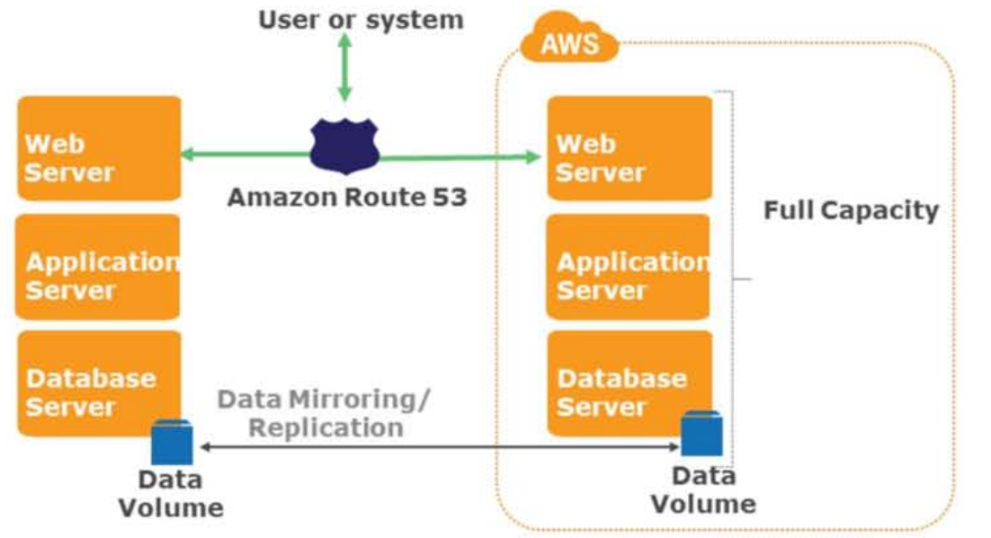
Multi-site Active-Active

Slide 35
Multi-site Active-Active
Advantages
At any moment can take all production load
Preparation
Similar to Low-Capacity Standby
Fully scaling in/out with production load
In case of Disaster
Immediately fail over all production load
Adjust DNS records to points to AWS
Objectives
RTO: as long as it takes fail over
RPO: depends on replication type

Slide 36
Hosted Desktop
Advantages
Replacement of workstations in case of disaster
Pay only when used for DR
Preparation
Set up AMIs with appropriate working environment
In Case of Disaster
Launch desktop AMI and resume work
Objectives
RTO: as long as it takes to launch AMI and restore work environment on virtual desktop
RPO: depends on state of AMI

Slide 37
Best Practices for Being Prepared
Start simple and work your way up
Backups in AWS as first step
Incrementally improve RTO/RPO as continuous effort
Check for any software licensing issues
Exercise your DR Solution
Game Day
Ensure backups, snapshots, AMIs, etc.. Are working
Monitor your monitoring system

Slide 38
Conclusion – Advantages of disaster recovery with AWS
Various building blocks available
Fine control overs cost vs. RTO/RPO tradeoffs
Ability to scale up when needed
Pay for what you use, and only when you use it(when an event happens)
Ability to easily and effectively test your DR plan
Availability of multiple locations world wide
Hosted desktops available
Variety of Solution Providers

Slide 39
Putting It Together: Incremental Improvement
Start with existing on-premise app with traditional DR
Gradually move DR (and thus the app) to the cloud:
Backup to S3 and Restore
“Pilot Light” on AWS for Quick Recovery
Fully Working Low Capacity Standby on AWS
Migrate to primary on AWS, DR on-premise
Add hot standby in second AWS AZ or Region
Incrementally add HA features to primary app
End Sate: Use HA techniques in-Region, use DR techniques for Region to Region resiliency

